Slide 1


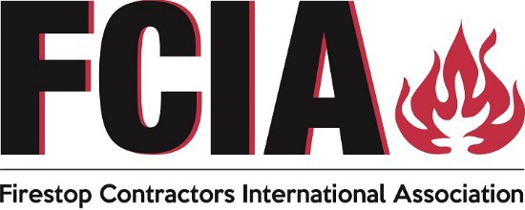
DIIM Worldwide Series
FREE STUFF
INFO@FCIA.org

Slide 2
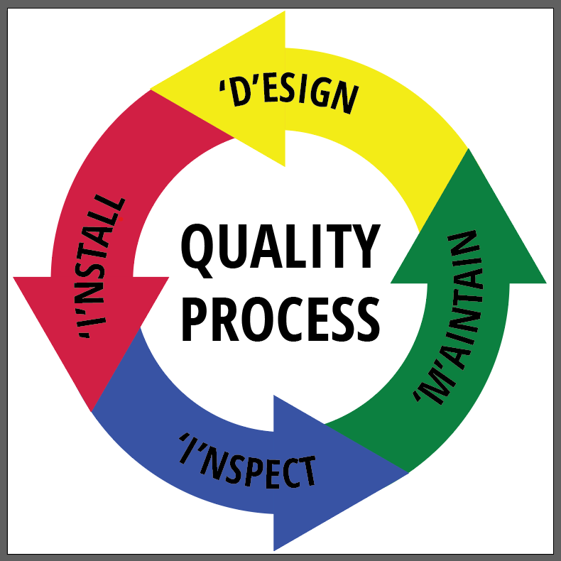
DESIGN
Specs, Code
FCIA’s DIIM™
INSTALLATION
FM 4991/UL QFCP Programs AND Mfr. Education
EC - PFP MAINTAIN PROTECTION
Fire Codes
INSPECTION
ASTM E2174/E2393
Notes:
The DIIM covers a lot.
D is D-Design…code requirements, specifications, systems created by the manufacturers and selection by barrier management survey and installation contractors.
I is I-Installation – in new construction and in existing buildings, organizations qualified through management system programs (UL QFCP, FM 4991, etc.) and workers educated by manufacturers, associations.
I is I-Inspection – in new construction, inspection in accordance with ASTM E2171/ASTM E2393 Inspection Standards for firestopping as required by NFPA 1, International Building Code, NPFA 80 for dampers, doors and glazing,.
M is Maintaining Protection – Maintaining fire-resistance as it was installed – so it works when called upon by fire. – in accordance with NFPA 1, NFPA 101, International Fire Code.

Slide 3
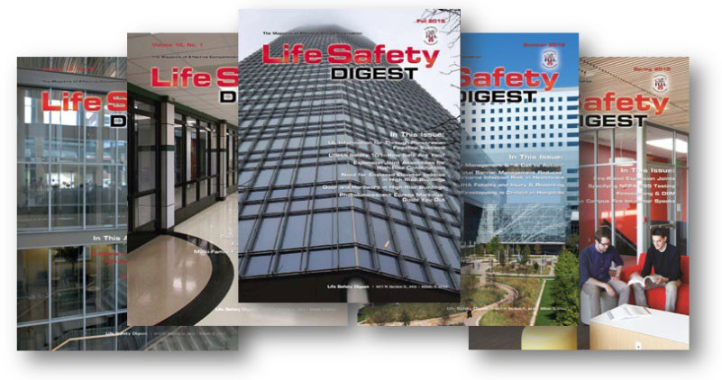
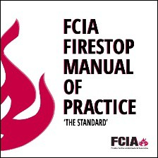
FCIA’s DIIM Worldwide
UL QFCP FM 4991 Contractor Programs
ASTM Inspection Standards
IAS AC 291 Inspection Agency Accreditation Program, FM & UL Firestop Exams
Firestop Education Program
Contractor, Inspection Agency, AHJ, Others
Resources for Specifiers, AHJ’s, Building Owners, Firestop Contractors & Inspection Agencies, Others

Slide 4
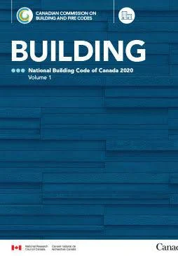
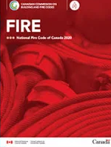
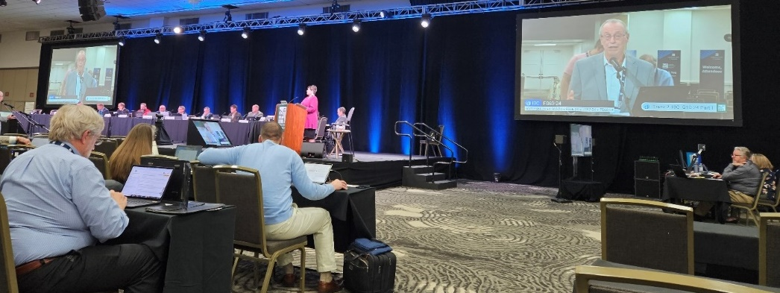


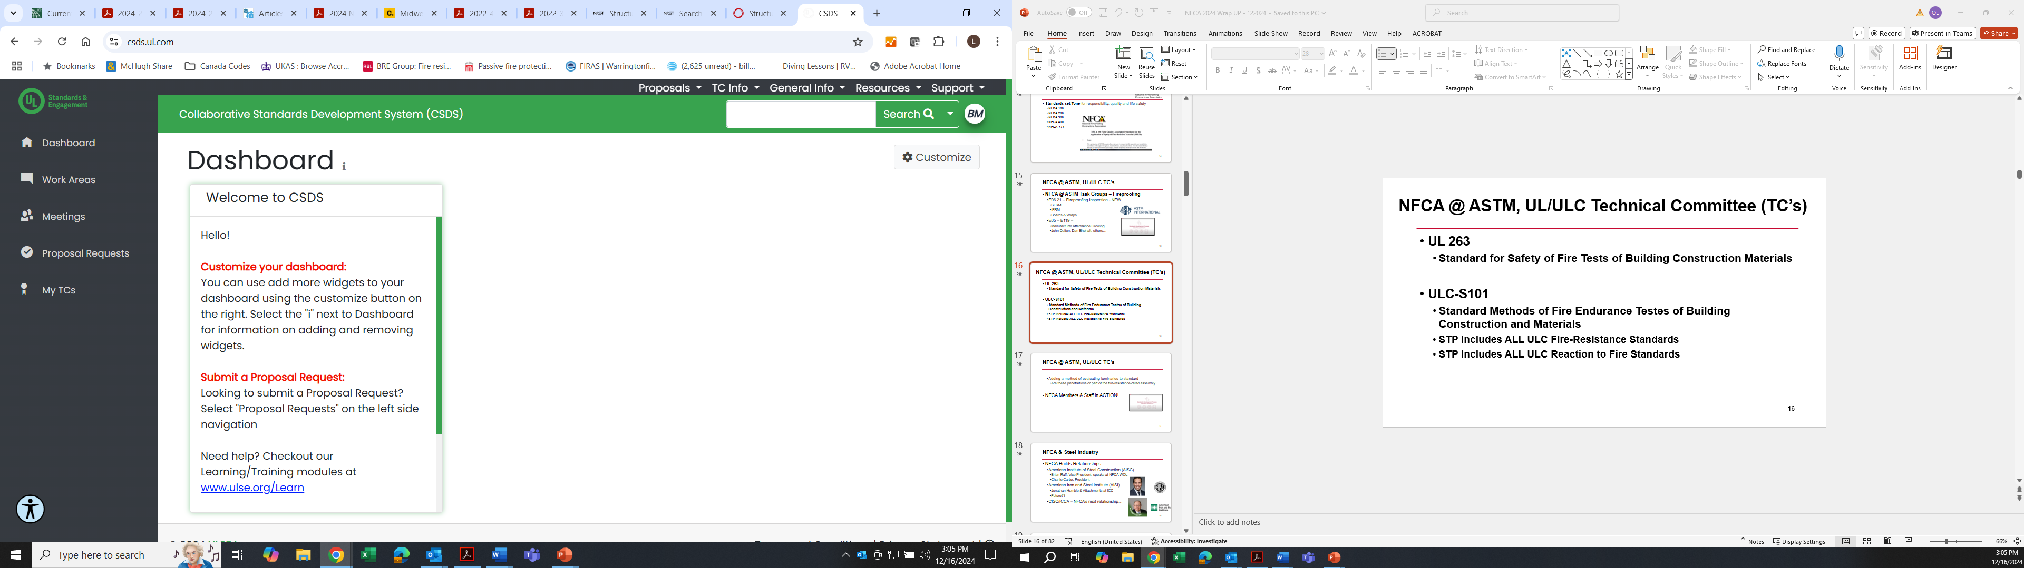
FCIA – Firestop Contractors International Association
FCIA @ NBCC/NFCC, CSC, RAIC, UL & ULC STP’s, CAN BOA’s ASTM, ICC, NFPA, more…
Advocacy….

Slide 5

FCIA’s DIIM Worldwide
FCIA DIIM = Industry Development
Life Safety Digest
Firestop Manual of Practice
Education for FM & UL Firestop Exams
Advocacy
Code Development
Standards Development
Speaking, Trade Shows
Firestop Education Program
• $1000/company/year…UNLIMITED USE…

Slide 6

FCIA’s NEWEST PROGRAM –
Education for Firestopping Careers!!
FCIA’s Firestop Education Program (FEP)
3.5 Hours Level 1 – DIIM ++
16.5 Hours Level 2 – Materials & Systems
4.0 Hours Level 3 – Project Management, Estimating
THE BASICS - Level 0 – LAUNCHED OCTOBER ‘25
3.5 Hours Level 1 Spanish – Soon!
24+ Hours Education…
30++ Hours = Education & Exams –
Members – Unlimited Subscription
Non-Members – Visit FCIA.org
SPECIFIERS, Code Officials, Fire Marshals – FREE Level 1

Slide 7
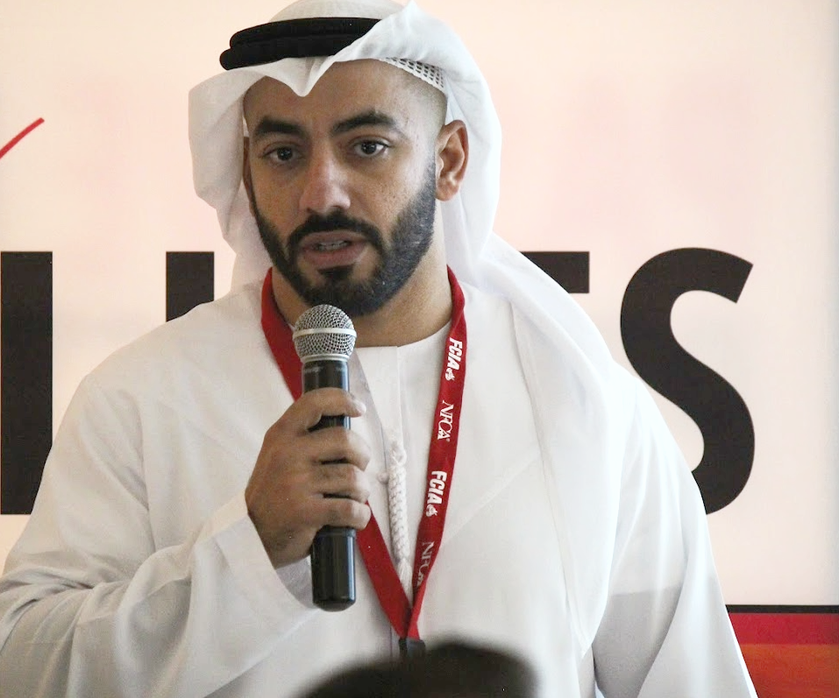
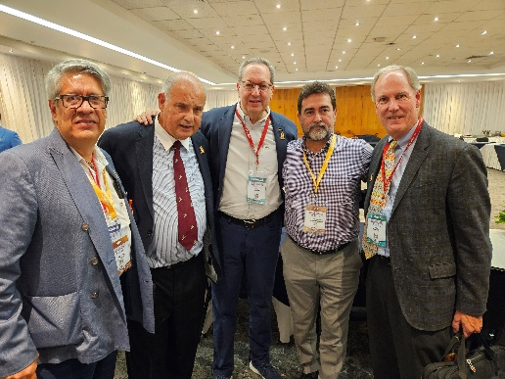
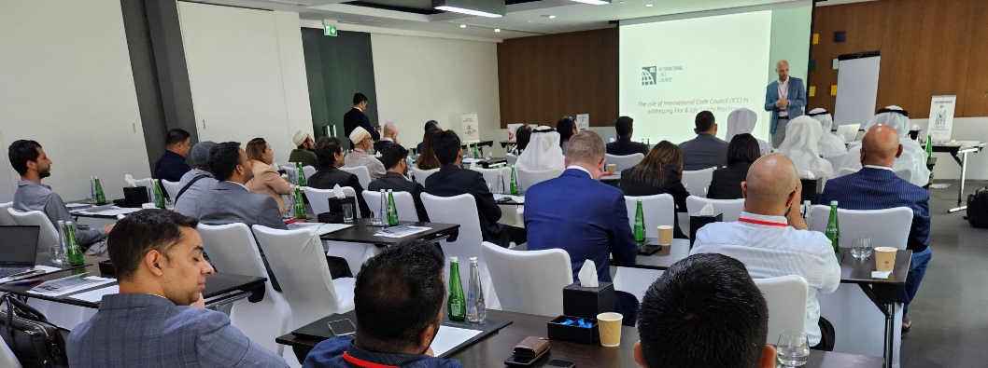
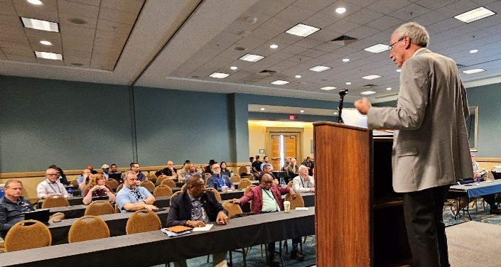


FCIA – Firestop Contractors International Association
Canada
India
Middle East –
Kuwait, Oman, Qatar
Saudi Arabia, United Arab Emirates
Mexico, Central/South America
Australia/New Zealand–Far East

Slide 8


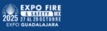
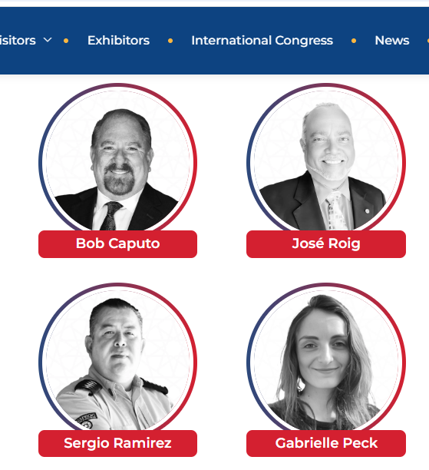

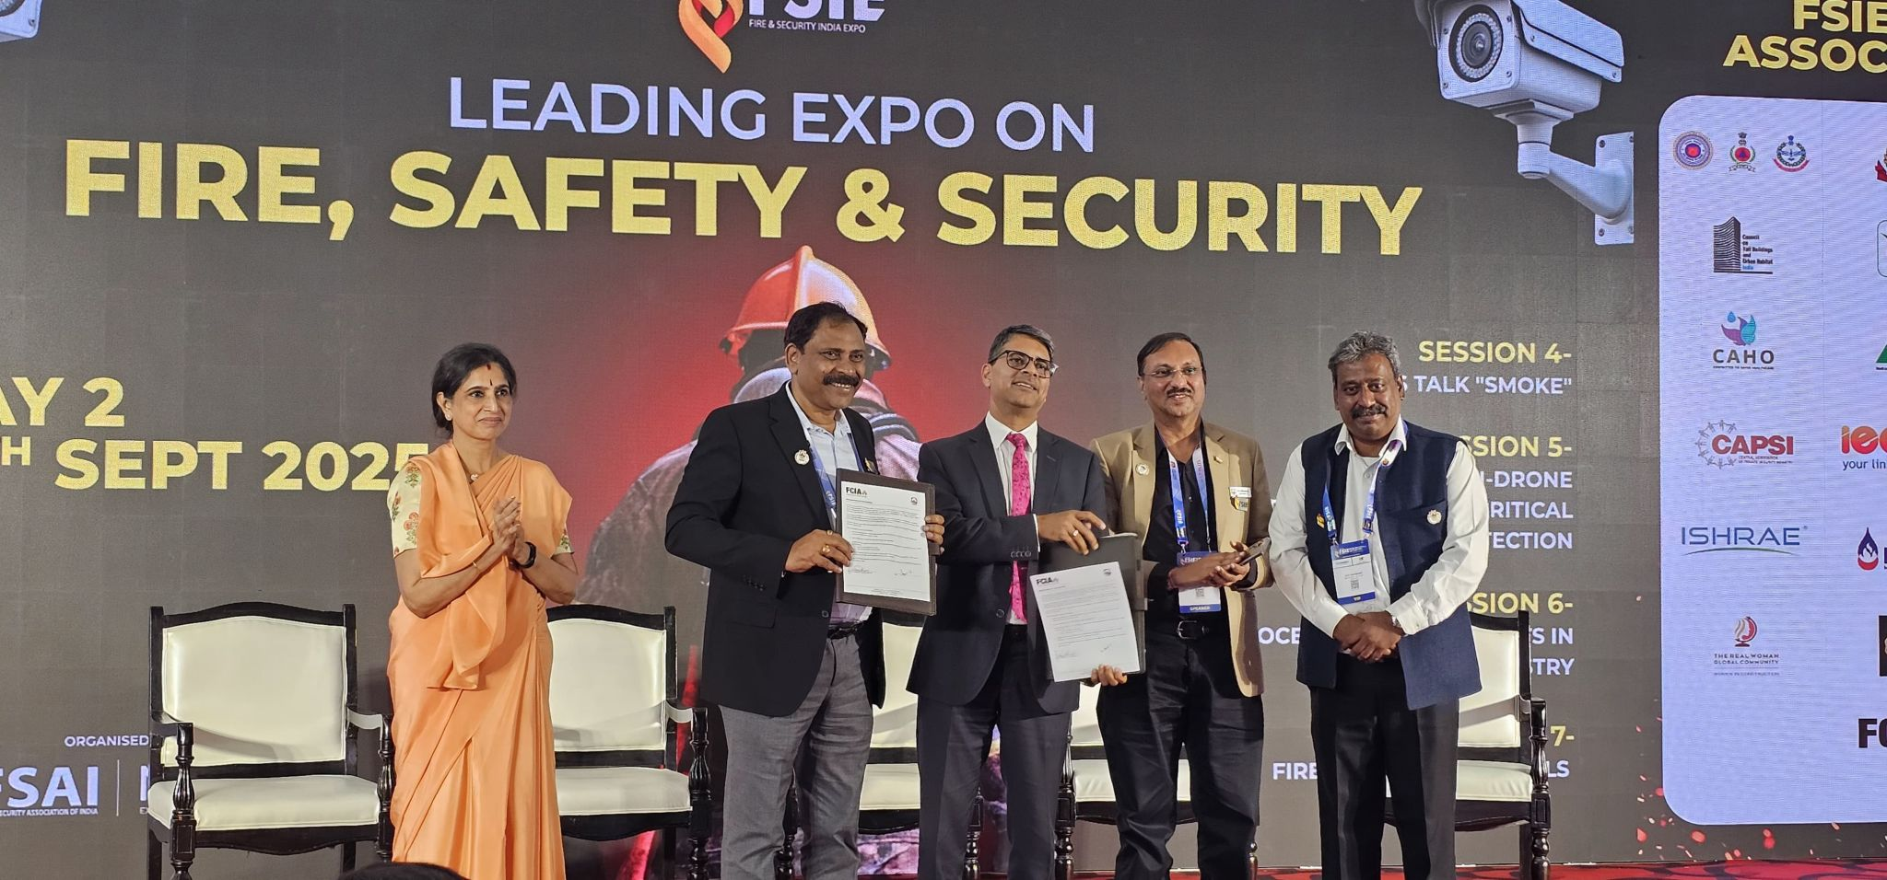
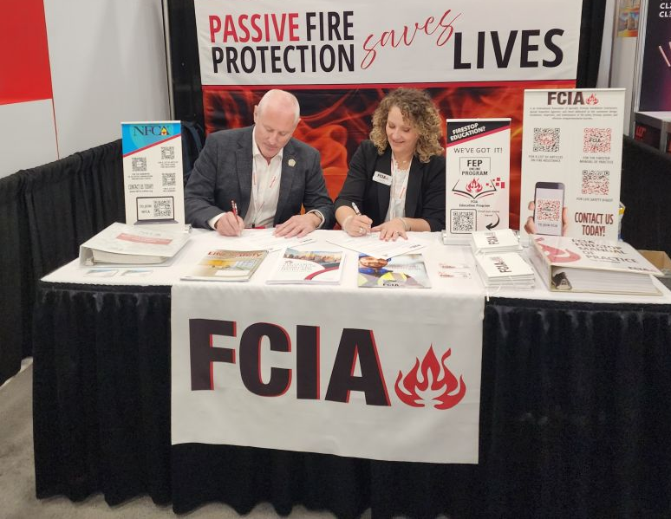

Slide 9
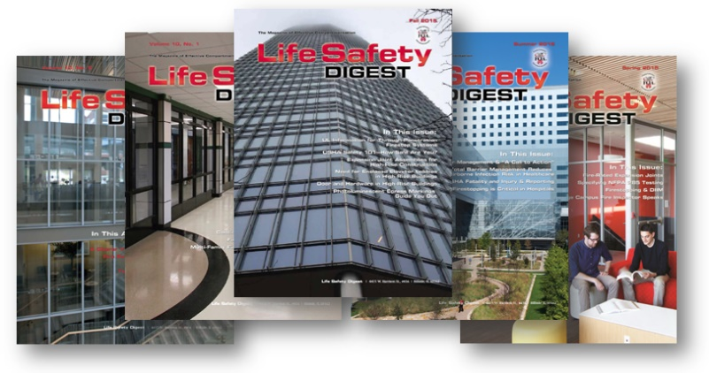
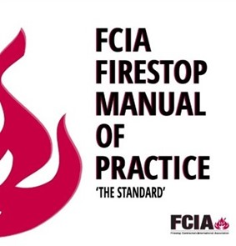
FREE RESOURCES
Info@FCIA.org - REQUEST FREE STUFF
FREE Life Safety Digest
FREE MOP, if you Qualify….
Firestopping DIIM™ Story – www.FCIA.org/About

Slide 10
DESIGN
Specs, Code
FCIA’s DIIM™
INSTALLATION
FM 4991/UL QFCP Programs AND Mfr. Education
EC - PFP MAINTAIN PROTECTION
Fire Codes
INSPECTION
ASTM E2174/E2393
Notes:
The DIIM covers a lot.
D is D-Design…code requirements, specifications, systems created by the manufacturers and selection by barrier management survey and installation contractors.
I is I-Installation – in new construction and in existing buildings, organizations qualified through management system programs (UL QFCP, FM 4991, etc.) and workers educated by manufacturers, associations.
I is I-Inspection – in new construction, inspection in accordance with ASTM E2171/ASTM E2393 Inspection Standards for firestopping as required by NFPA 1, International Building Code, NPFA 80 for dampers, doors and glazing,.
M is Maintaining Protection – Maintaining fire-resistance as it was installed – so it works when called upon by fire. – in accordance with NFPA 1, NFPA 101, International Fire Code.

Slide 11
DIIM Worldwide Series
FREE STUFF
INFO@FCIA.org

